Slide 1
Recognition and classification of yield affecting paddy crop stresses using field images
Guide: Submitted By:
FOUSIA M SHAMSHUDEEN ASHLY ELIZABETH JOSHY(07)
SREELAKSHMI.S(29)

Slide 2
CONTENTS
INTRODUCTION
TECHNOLOGIES USED
DESIGN
RESULT

Slide 3
INTRODUCTION
Aims to design different convolutional neural network (CNN) framework for automatic recognition and classification of various paddy crop stresses using the field images.
The work has adopted CNN, pre-trained VGG-16 CNN, InceptionV3, Mobile Net model for the classification of stressed paddy crop images .
It also aims to recommend remedies for each stresses affecting the paddy crop.

Slide 4
TECHNOLOGIES USED
OS: Windows 10
Back end: Python TensorFlow deep learning framework
Library: Keras
Classification: CNN, Mobile Net ,VGG-16(Virtual Geometry Group), InceptionV3
Features: Colour, Shape, Texture
Dataset : Rice-leaf(stresses: Bacterial blight, Leaf Smut, Brown spot)

Slide 5
DESIGN
Dataset
Resizing images in dataset
Attribute Selection
Training Data
Splitting Dataset
Into Training and Validation
Test Data
Bacterial leaf blight
Brown spot
Remedies
Apply Classification Algorithms
Classification Model
Predictions of Classifying three stresses
Leaf smut

Slide 6
MOBILE NET
Mobile net as it is lightweight in its architecture.
Mobile Net is a class of CNN that was open-sourced by Google, and therefore, this gives us an excellent starting point for training our classifiers that are insanely small and insanely fast.
Mobile Net uses depth wise separable convolutions. It significantly reduces the number of parameters when compared to the network with regular convolutions with the same depth in the nets. This results in lightweight deep neural networks.
Mobile Net are small, low-latency, low-power models parameterized to meet the resource constraints of a variety of use cases. They can be built upon for classification, detection, embeddings and segmentation similar to how other popular large scale models, such as Inception, are used.

Slide 7
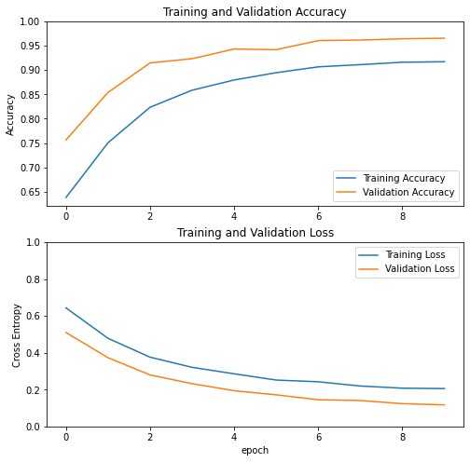

Slide 8
VGG16
VGG16 is a convolution neural net (CNN ) architecture.
It stands for Visual Geometry Group from Oxford.
It is considered to be one of the excellent vision model architecture till date.
Most unique thing about VGG16 is that instead of having a large number of hyper-parameter they focused on having convolution layers of 3x3 filter with a stride 1 and always used same padding and max pool layer of 2x2 filter of stride 2.
It follows this arrangement of convolution and max pool layers consistently throughout the whole architecture.

Slide 9
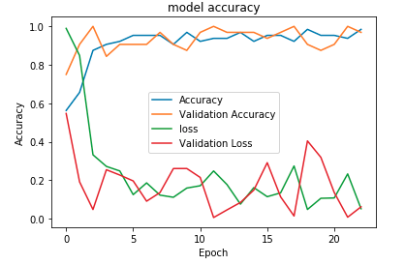

Slide 10
Inception v3
Inception v3 is a widely-used image recognition model that has been shown to attain greater than 78.1% accuracy on the ImageNet dataset.
The model itself is made up of symmetric and asymmetric building blocks, including convolutions, average pooling, max pooling, concats, dropouts, and fully connected layers.
Inception V3 was trained using a dataset of 1,000 classes from the original ImageNet dataset which was trained with over 1 million training images.

Slide 11
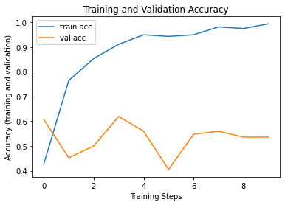
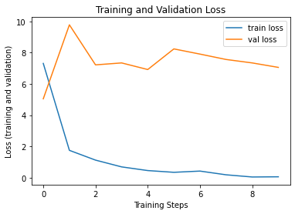

Slide 12
Convolutional Neural Network(CNN)
A Convolutional Neural Network (ConvNet/CNN) is a Deep Learning algorithm which can take in an input image, assign importance (learnable weights and biases) to various aspects/objects in the image and be able to differentiate one from the other.
The pre-processing required in a ConvNet is much lower as compared to other classification algorithms. While in primitive methods filters are hand-engineered, with enough training.
ConvNet have the ability to learn these filters/characteristics.

Slide 13
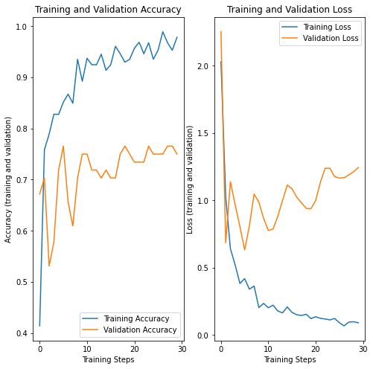

Slide 14
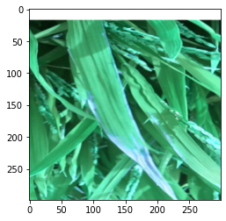
SOURCE: class: bacterial_leaf_blight,
file:bacterial_leaf_blight/blight_rotated_012.png
PREDICTED: class: Bacterial_leaf_blight, confidence: 0.493930
<Figure size 432x288 with 0 Axes>

Slide 15
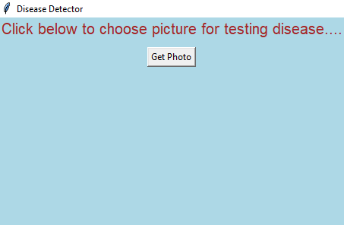
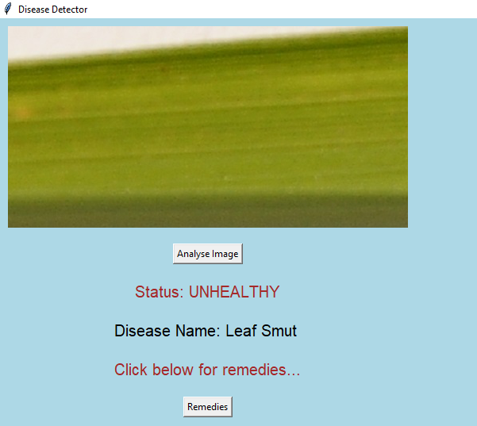
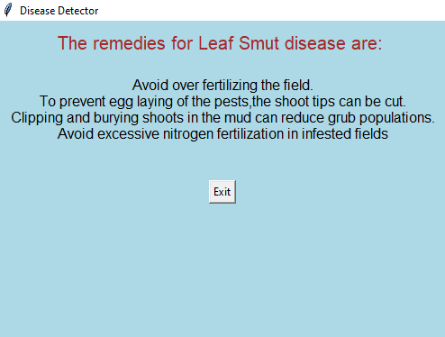
Remedy Recommendation - CNN
Spyder is a free and open source scientific environment written in Python, for Python, and designed by and for scientists, engineers and data analysts.

Slide 16
THANK YOU

